Slide 1
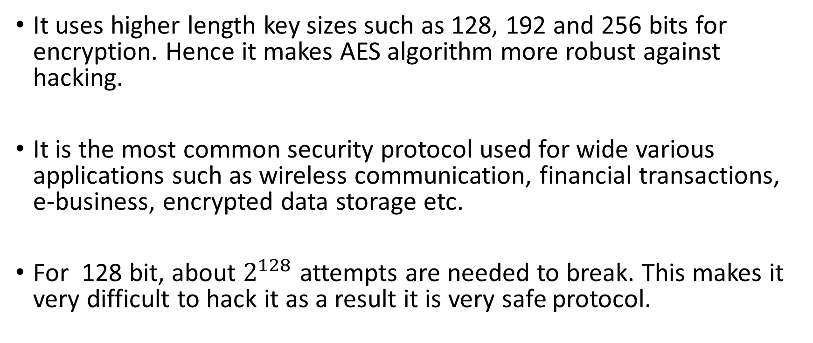
Why AES?
It uses higher length key sizes such as 128, 192 and 256 bits for encryption. Hence it makes AES algorithm more robust against hacking.
It is the most common security protocol used for wide various applications such as wireless communication, financial transactions, e-business, encrypted data storage etc.
For 128 bit, about $2^{128}$ attempts are needed to break. This makes it very difficult to hack it as a result it is very safe protocol.

Slide 2
WORKING OF AES
AES repeats 4 major functions to encrypt data. It takes 128 bit block of data and a key and gives a ciphertext as output. The functions are:
I. Sub Bytes
II. Shift Rows
III. Mix Columns
IV. Add Key
The number of rounds performed by the algorithm strictly depends on the size of key.
Key Size(in bits) Rounds
128.................................................10
192.................................................12
256.................................................14

Slide 3
ANALYSIS OF STEPS
Key Expansions- In the key Expansion process the given 128 bits cipher key is stored in [4]x[4] bytes matrix (16*8=128 bits) and then the four column words of the key matrix is expanded into a schedule of 44 words (44*4=176) resulting in 11 round keys (176/11=16 bytes or 128 bits).
Number of round keys = Nr + 1. Where Nr is the number of rounds (which is 10 in case of 128 bits key size) So here the round keys = 11.

Slide 4
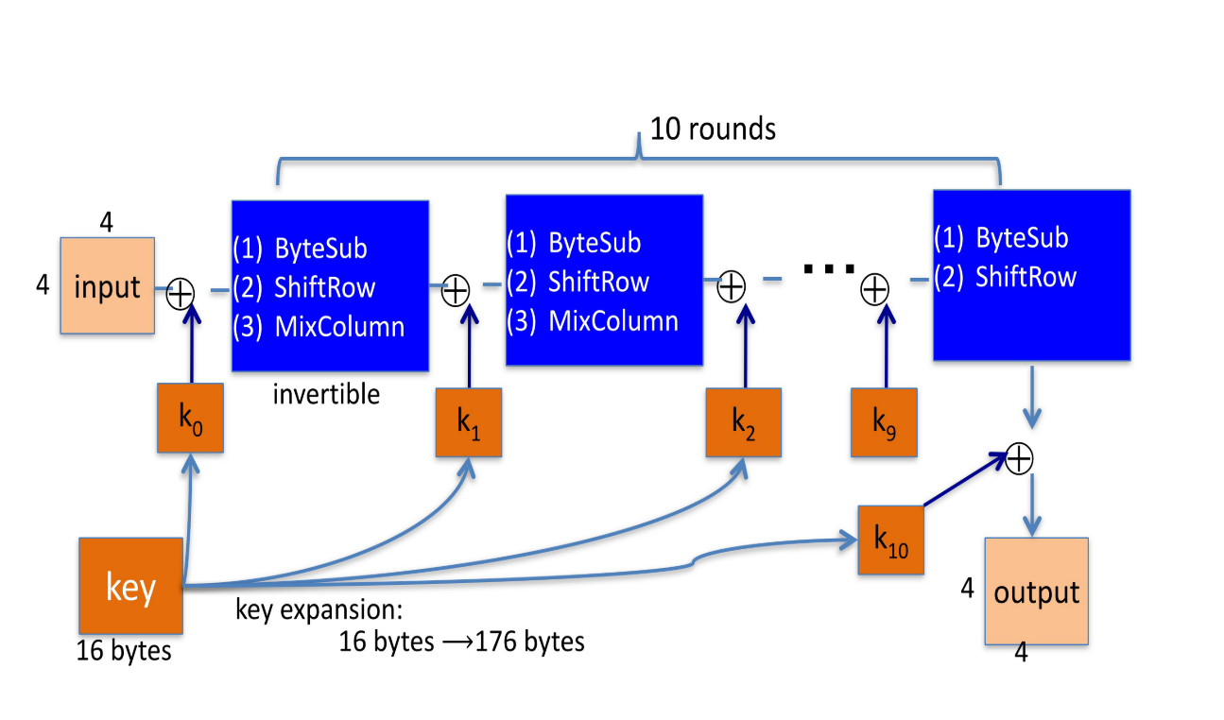

Slide 5
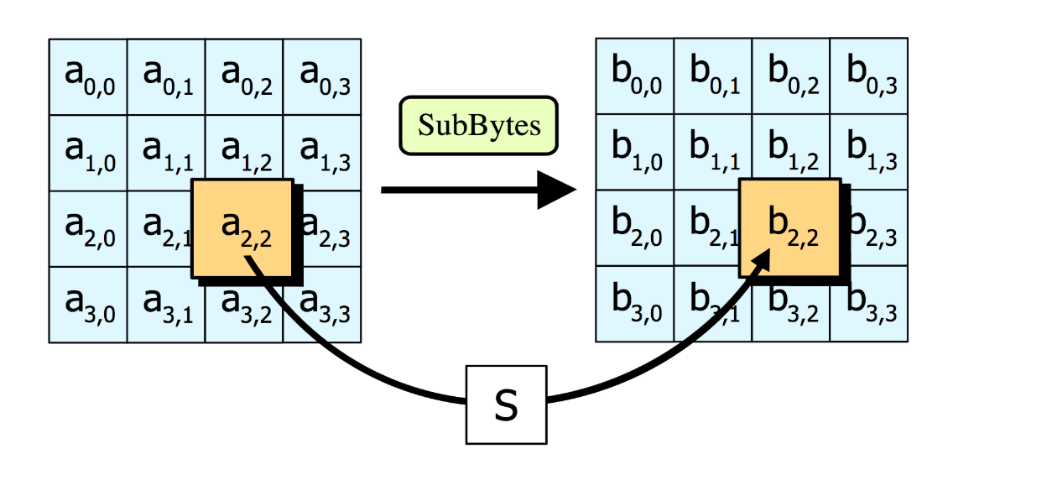
STEP 1: SUB BYTES
Sub Bytes- Each element of the matrix is replaced by the an element of s-box matrix.

Slide 6
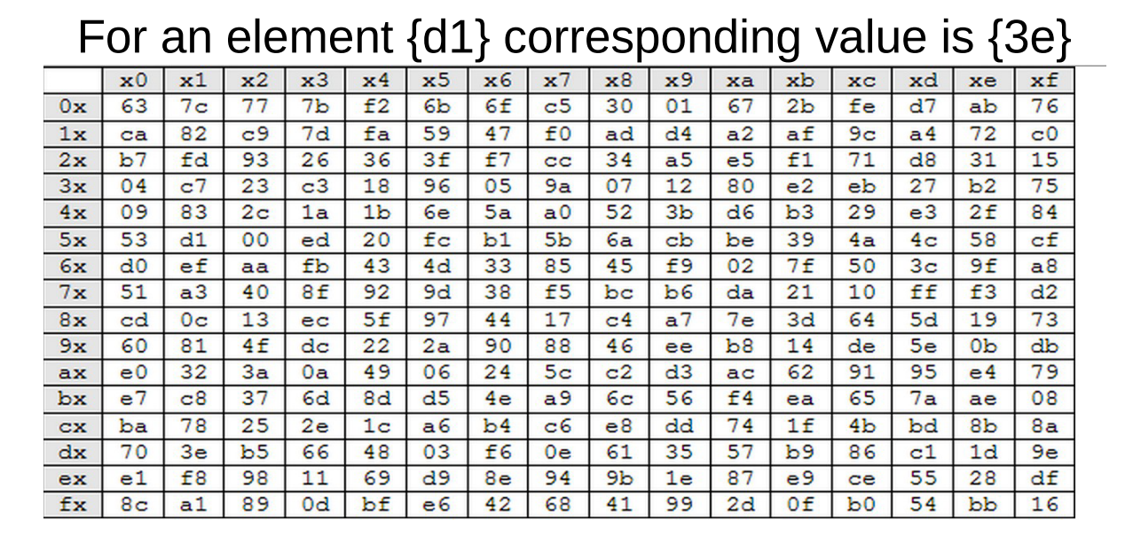
Rijndael S-Box

Slide 7
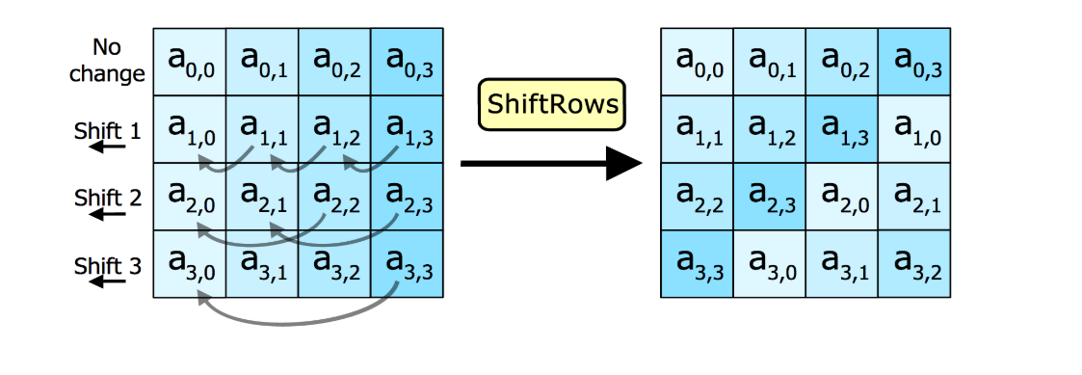
STEP 2: SHIFT ROWS
In this step rows of the block are cylindrically shifted in left direction.
The first row is untouched , the second by one shift, third by two and fourth by 3.

Slide 8
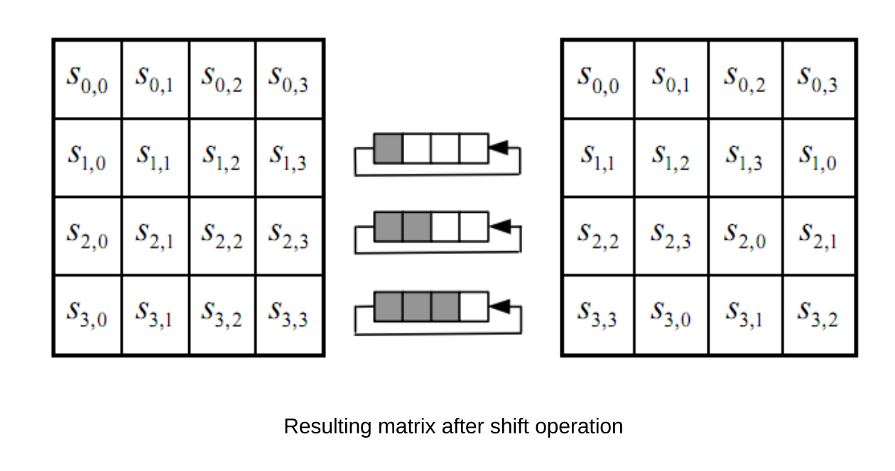

Slide 9
STEP 3: MIX COLUMNS
This is the most important part of the algorithm
It causes the flip of bits to spread all over the block
In this step the block is multiplied with a fixed matrix.
The multiplication is field multiplication in Galois field.
For each row there are 16 multiplication, 12 XORs and a 4-byte output.

Slide 10
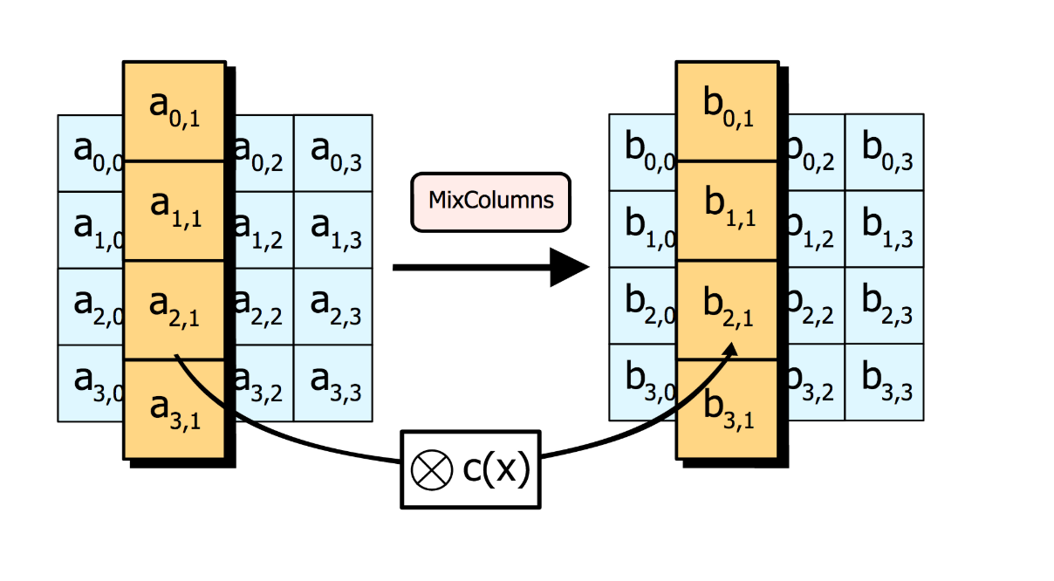

Slide 11
STEP 4: ADD ROUND KEY
In this step each byte is XOR-ed with corresponding element of key's matrix.
Once this step is done the keys are no longer available for this step. Using the same key will weaken the algorithm.
To overcome this problem keys are expanded.

Slide 12
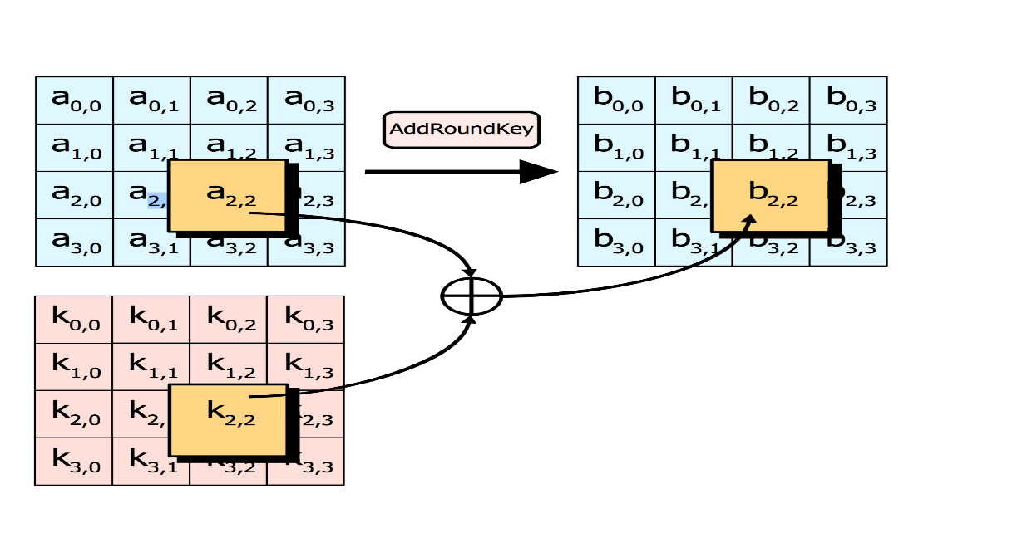

Slide 13
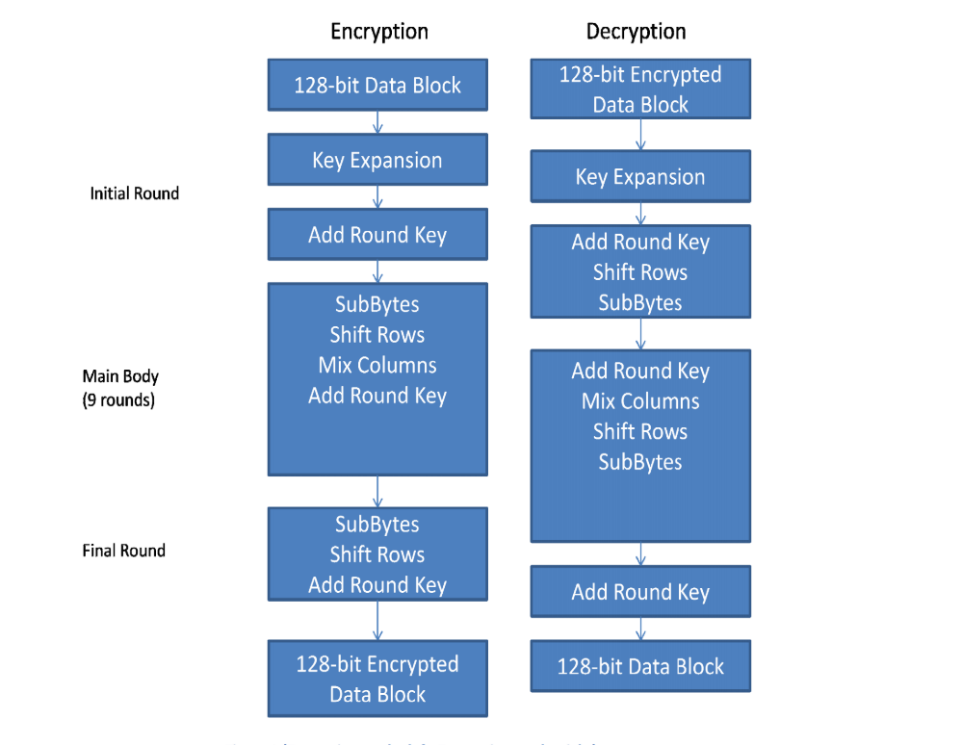
STEPS FOR ENCRYPTION AND DECRYPTION

